Slide 1


"EatFit" Flutter Project
Timur Mergenov Nurgul Mazhit Ravil Amangelldiuly Dilnaz Anarkul
Преподаватель: Ирина Буркова

Slide 2
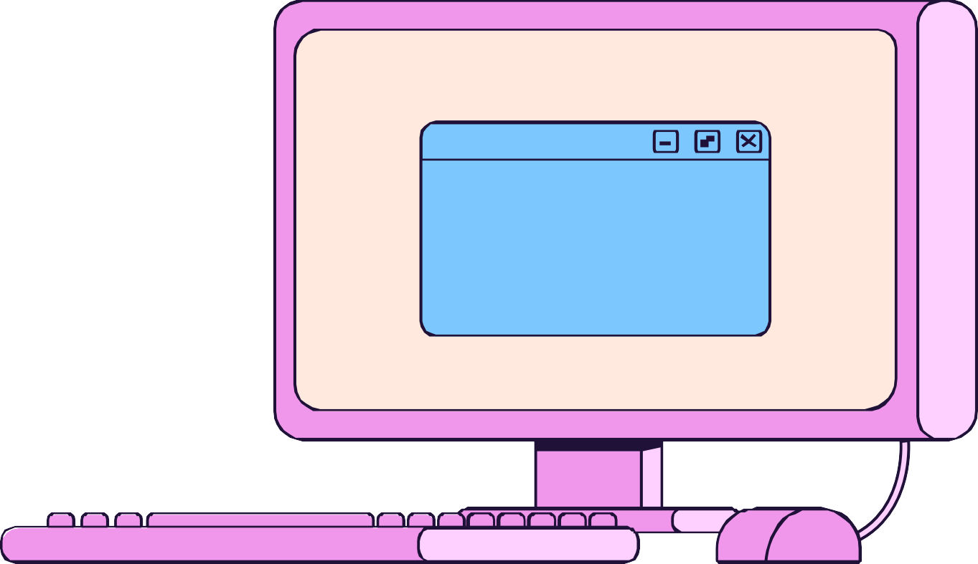
Main Purpose
This app can be used by anyone who wants to improve their body. In application, you can write down your physical data, from which the necessary information will be calculated.

Slide 3

Our floals
Understanding the basics of Flutter technology in practice
Understanding mobile development patterns
Implementation of the acquired knowledge in practice
Creation of an app that will help you improve your physique

Slide 4

Application content
In app you can find the calorie content of products,calorie expenditure, and training for every large muscle group with your own weight.
You can add your favorite recipes
The exercises are designed for people with average physical fitness and do not require any equipment.
Exercises are designed with own weight,
minimizing the possibility of injury

Slide 5
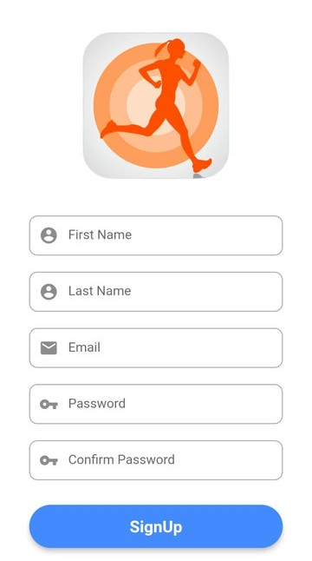
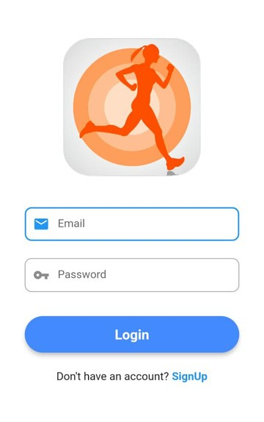
Authorization and Login Page
Authorization and Login page where user can create own account or enter existing.
The data in authorization page is saved in database

Slide 6
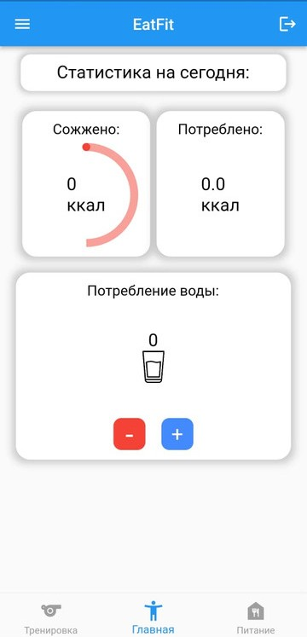
Main Page
This page shows statistics of burned calories and water that is drunk.
Furthermore, calories consumed is used

Slide 7
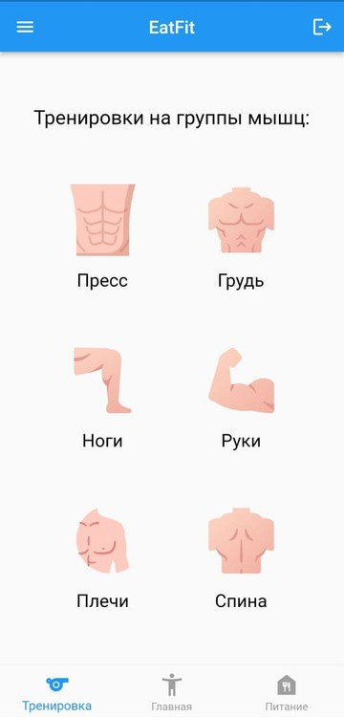
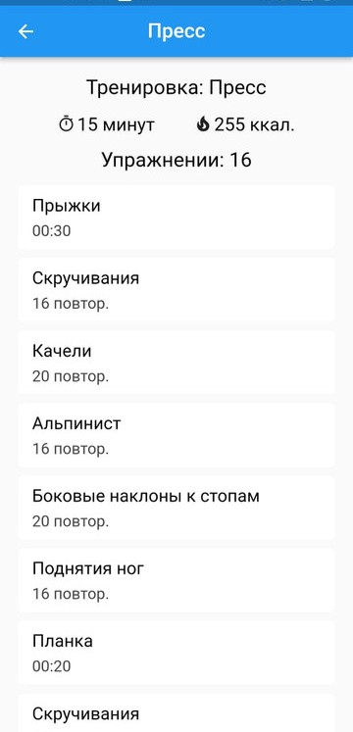

Exercises
The special training system fof different group of muscles and repetition of exercises

Slide 8
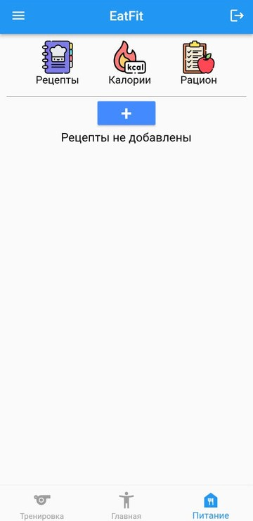
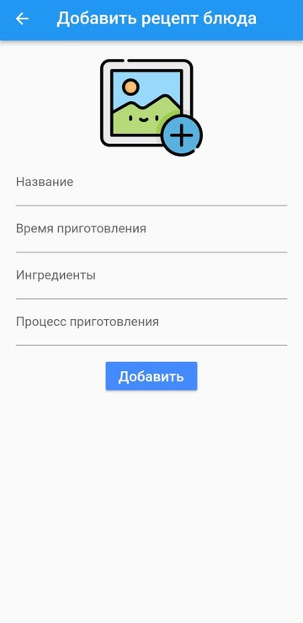
Recipe Addition
Other feature of our application is adding recipe. It is then added to the list of recipes

Slide 9
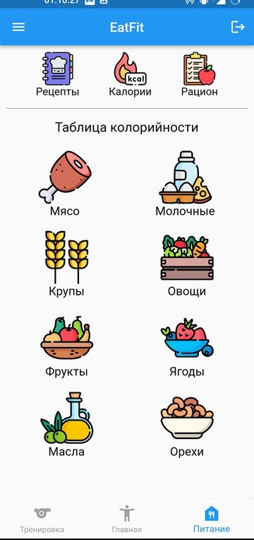
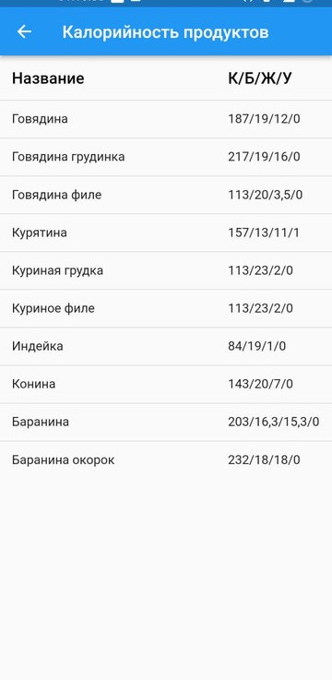
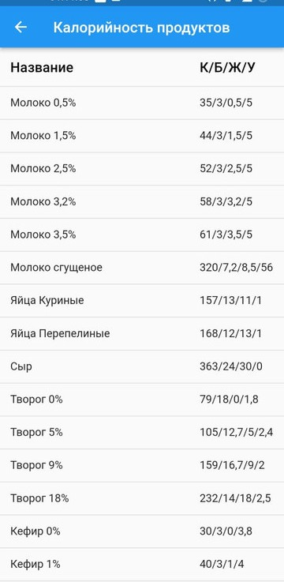
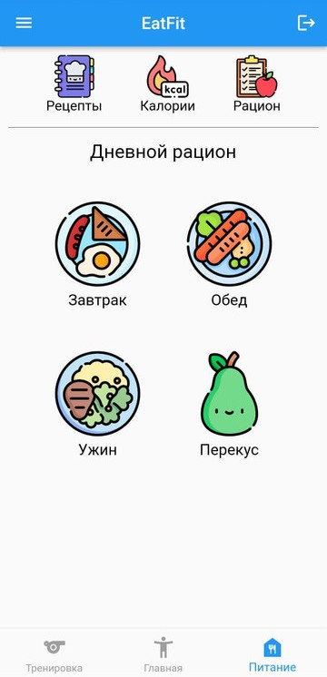
Nutrition
This page shows caloric content of products

Slide 10
Profile Page
Personal Data about person will be shown

Slide 11
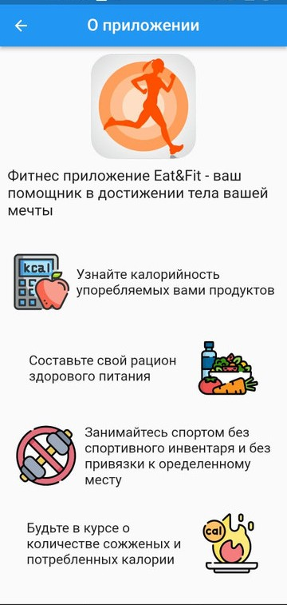
About Application Page
Here you can find information about application and find anwsers for your questions

Slide 12
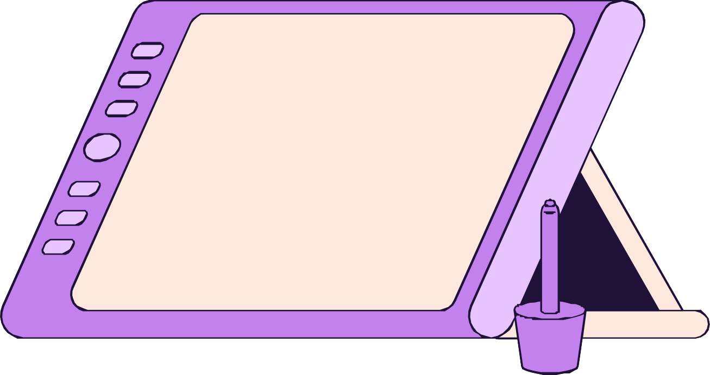
Thank you for attention!

